Slide 1


Hi ! I am Numi,
Your virtual assistant !
By:Tommy Lu And Richard Wong

Slide 2

Number Properties
Series & Sequences
Geometry
Basic Mathematical Operation
Equations
Miscellaneous
Fun Activities

Slide 3
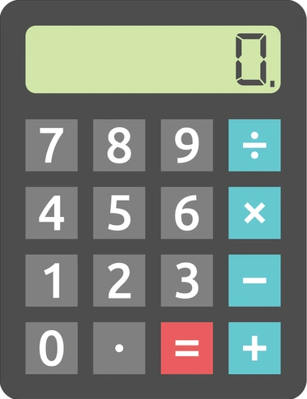
Basic Mathematical Operation
1. Basic arithmetic (+-*/) [1-4][39-40]
2. Average of two numbers [5]
3. Absolute value [9]
4. Square root [8]
5. Sum of squares [20]
6. Meal cost and tip calculator [45]
7. Random number generator [46]
8. Random number generator between two numbers [47]
Return

Slide 4
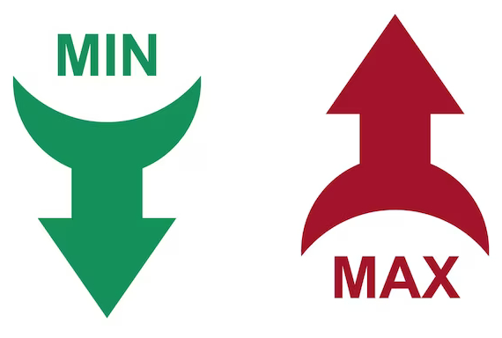
Number Properties
1. Check even/odd [6]
2. Check positive/negative/zero [7]
3. Find largest of two numbers [38]
4. Find smallest of three numbers [18]
5. Find largest of three numbers [19]
6. Find min and max of three numbers [21]
7. Array addition with pointers [66]
8. Array subtraction with pointers [67]
9. Array multiplication with pointers [68]
10. Array division with pointers [69]
11. Array modulo with pointers [70]
Return

Slide 5
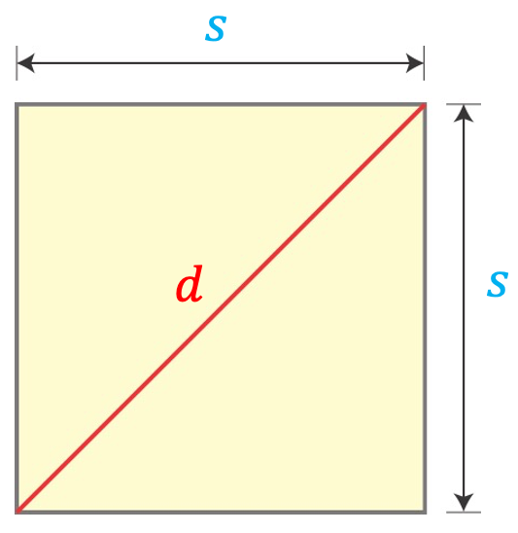
Geometry
1. Calculate square perimeter and area [10]
2. Calculate hypotenuse [14]
3. Cube, sphere cylinder volume [49]
Return

Slide 6
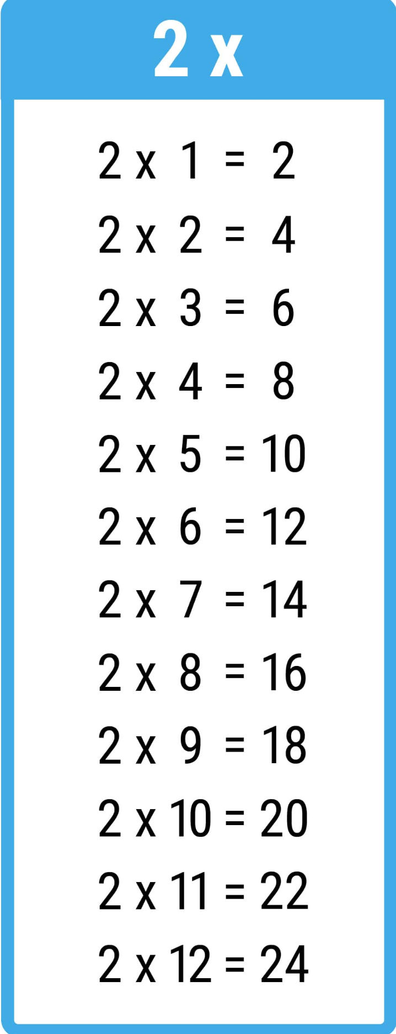
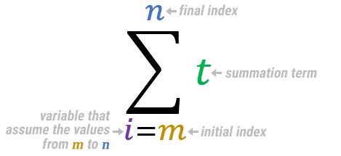
Series & Sequences
1. Multiplication table of 2 [11-13]
2. Sum of first 100 integers [22]
3. Sum of first 100 even integers [23]
4. Sum of first N integers [26]
5. Sum of first N even integers [27]
6. Factorial [52]
7. Fibbonaci number calculation [53]
8. Sum of digits calculation [54]
Return

Slide 7
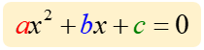
Equations
1. Solve first-degree equation [24]
2. Solve second-degree equation [25]
3. Inverse matrix method for two
linear equations [58]
4. Solve system of 3 linear equations [59]
5. Linear regression [61-62]
Return

Slide 8
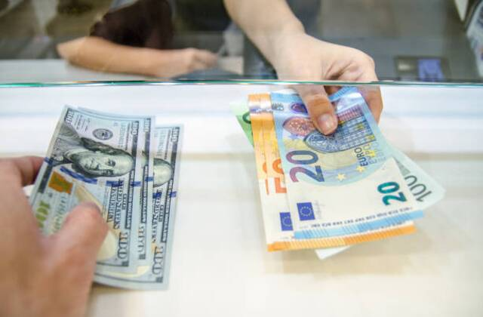

Miscellaneous
1. Currency exchange [15-16]
2. Swap numbers [17]
3. Convert distance (km/m) [28]
4. Array operations [31-33]
5. User input array operations [34]
6. Multiply array by number [35]
7. Matrix operations [37]
8. Point Class [55]
9. Shape Class [56]
10. Animal Class [57]
11. Weight conversion [41]
12. Bubble Sort [42]
13. Selection Sort [43]
14. Merge Sort [44]
15. Timezone conversion [48]
16. CSV Age Reader [72]
17. CSV Sales Calculator [73]
Return

Slide 9

Fun Activities
1. T-Shirt Customization [30]
2. Quiz Game [29]
3. Halloween Game [51]
4. Tic-Tac-Toe [63]
5. Conway's Game of Life [64]
6. Minesweeper [60]
7. Pointer Demonstration [65]
8. Wellness Bot [71]
9. Mental Wellness Bot [80]
10. Student Management System [74-75]
11. Product Inventory Management System [76]
12. Library Management System [77]
13. Employee Management System [78]
14. Silly Adventure Game [79]
Return

